Slide 1
Principles of Marketing
Chapter#9
New-Product Development and Product Life-Cycle Strategies

Slide 2


Slide 3
New-Product Development Strategy
Two ways to obtain new products
Acquisition refers to the buying of a whole company, a patent, or a license to produce someone else’s product.
New product development refers to original products, product improvements, product modifications, and new brands developed from the firm’s own research and development

Slide 4
Reasons for new product failure
Overestimation of market size
Poor design
Incorrect positioning
Wrong timing
Priced too high
Ineffective promotion
Management influence
High development costs
Competition

Slide 5
New-Product Development Process
Idea generation
Idea Screening
Concept Development & testing
Marketing Strategy Development
Business Analysis
Product Development
Test Marketing
Commercialization

Slide 6
1. Idea Generation
Idea generation is the systematic search for new-product ideas
Sources of new-product ideas
Internal Sources
R&D
Sales force/employees
External Sources
Customers
Resellers
Suppliers
Competitors
Advertising Agencies
Marketing research firms

Slide 7
2. Idea Screening
Identify good ideas and drop poor ideas.
R-W-W Screening Framework:
Is it real?
Can we win?
Is it worth doing?

Slide 8
3. Concept Development and Testing
Product idea is an idea for a possible product that the company can see itself offering to the market
Product concept is a detailed version of the idea stated in meaningful consumer terms
Product image is the way consumers perceive an actual or potential product
Concept testing refers to testing new-product concepts with groups of target consumers

Slide 9
4. Marketing Strategy Development
Marketing strategy development refers to the initial marketing strategy for introducing the product to the market
Marketing strategy statement includes:
Description of the target market
The target market, product positioning, and sales, share, and profit goals for the first few years.
Value proposition
Product price, distribution, and marketing budget for the first year.
Sales and profit goals
Long-run sales and profit goals and the marketing mix strategy.

Slide 10
5. Business Analysis
Business analysis involves a review of the sales, costs, and profit projections to find out whether they satisfy the company’s objectives.

Slide 11
6. Product Development
Product development involves the creation and testing of one or more physical versions by the R&D or engineering departments
Requires an increase in investment

Slide 12
7. Test Marketing
Test marketing is the stage at which the product and marketing program are introduced into more realistic marketing settings.
Provides the marketer with experience in testing the product and entire marketing program before full introduction
Types of Test Marketing
Standard Test Marketing
(full marketing campaign in a small number of representative cities)
Controlled Test Marketing
(A few stores that have agreed to carry new products for a fee)
Simulated Test Marketing
(Test in a simulated shopping environment to a sample of consumers)

Slide 13
8. Commercialization
Commercialization is the introduction of the new product.
When to launch
Where to launch
Planned market rollout

Slide 14
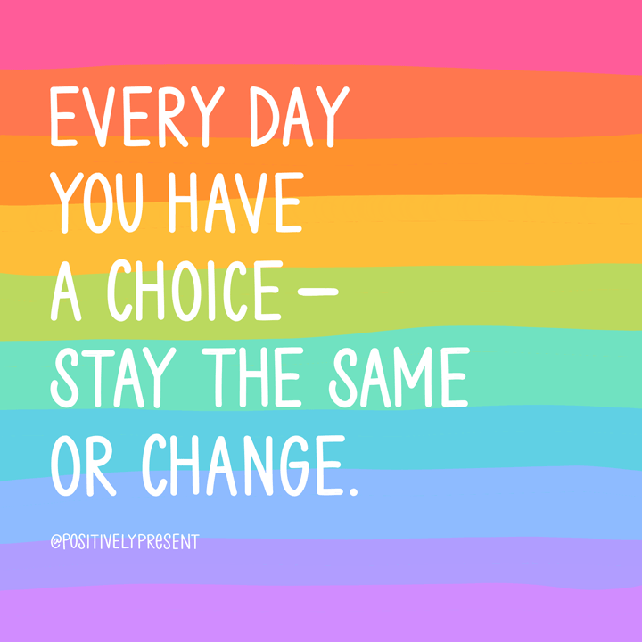

Slide 15
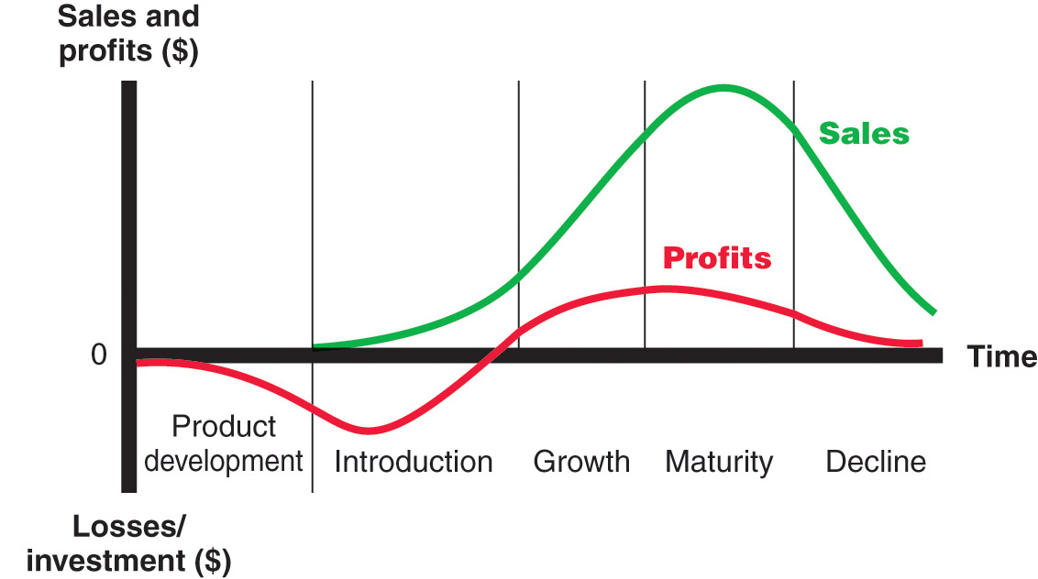
Product Life Cycle

Slide 16
Product Life Cycle
The Typical Product Life Cycle (PLC) Has Five Stages
Product Development, Introduction, Growth, Maturity, Decline
Not all products follow this cycle
The four basic stages through which a successful product progresses-introduction, growth, maturity, and decline.
Some products move rapidly through the product life cycle, while others pass through those stages over long time periods.

Slide 17
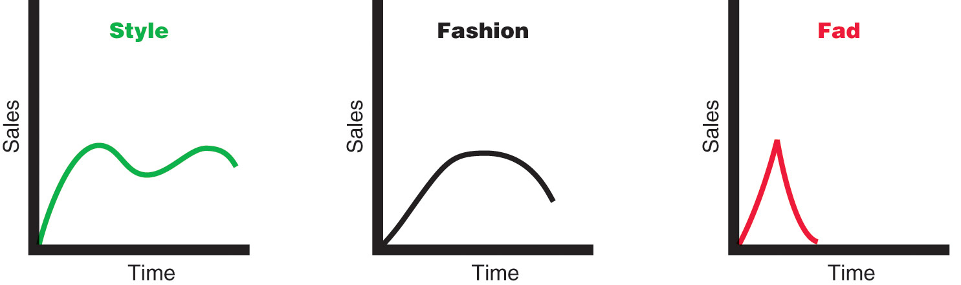
Product Life Cycle
Style is a basic and distinctive mode of expression.
Fashion is a currently accepted or popular style in a given field.
Fads are temporary periods of unusually high sales driven by consumer enthusiasm and immediate product or brand popularity.

Slide 18
Product Life-Cycle Strategies

Slide 19
PLC Stages
Begins when the company develops a new-product idea
Sales are zero
Investment costs are high
Profits are negative
Product development
Introduction
Growth
Maturity
Decline

Slide 20
Product Life Cycle Stages

Slide 21
PLC Stages
Low sales
High cost per customer acquired
Negative profits
Innovators are targeted
Little competition
Product development
Introduction
Growth
Maturity
Decline

Slide 22
Sales
Low sales
Costs
High cost per customer
Profits
Negative
Marketing Objectives
Create product awareness
and trial
Product
Offer a basic product
Price
Use cost-plus
Distribution
Build selective distribution
Advertising
Build product awareness among early adopters and dealers

Slide 23
Product Life Cycle Stages

Slide 24
PLC Stages
Rapidly rising sales
Average cost per customer
Rising profits
Early adopters are targeted
Growing competition
Product development
Introduction
Growth
Maturity
Decline

Slide 25
Sales
Rapidly rising sales
Costs
Average cost per customer
Profits
Rising profits
Marketing Objectives
Maximize market share
Product
Offer product extensions, service, warranty
Price
Price to penetrate market
Distribution
Build intensive distribution
Advertising
Build awareness and interest in the mass market

Slide 26
Product Life Cycle Stages

Slide 27
PLC Stages
Sales peak
Low cost per customer
High profits
Middle majority are targeted
Competition begins to decline
Product development
Introduction
Growth
Maturity
Decline

Slide 28
Sales
Peak sales
Costs
Low cost per customer
Profits
High profits
Marketing Objectives
Maximize profit while defending
market share
Product
Diversify brand and models
Price
Price to match or best competitors
Distribution
Build more intensive distribution
Advertising
Stress brand differences and benefits

Slide 29
Product Life Cycle Stages

Slide 30
PLC Stages
Declining sales
Low cost per customer
Declining profits
Laggards are targeted
Declining competition
Product development
Introduction
Growth
Maturity
Decline

Slide 31
Sales
Declining sales
Costs
Low cost per customer
Profits
Declining profits
Marketing Objectives
Reduce expenditure and milk the brand
Product
Phase out weak items
Price
Cut price
Distribution
Go selective: phase out unprofitable outlets
Advertising
Reduce to level needed to retain
hard-core loyal customers

Slide 32
Product Life Cycle

Slide 33
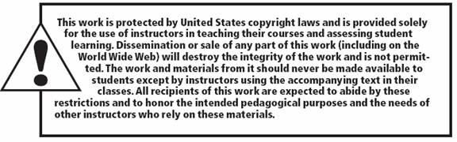
All rights reserved. No part of this publication may be reproduced, stored in a retrieval system, or transmitted, in any form or by any means, electronic, mechanical, photocopying, recording, or otherwise, without the prior written permission of the publisher. Printed in the United States of America.
Copyright © 2010 Pearson Education, Inc.
Publishing as Prentice Hall

